Slide 1


Rohan N Kalpavruksha - PES1201802830 Roshan N Kalpavruksha - PES1201802834 Bhavani Shankar - PES1201801864
SUMMER INTERNSHIP PROJECT DEMONSTRATION
Project Title : MEDICAL IMAGE ENCRYPTION USING DNA CRYPTOGRAPHY
Project ID :
Project Guide : RAJASHREE SOMAN
Project Team : ROHAN N KALPAVRUKSHA
ROSHAN N KALPAVRUKSHA
BHAVANI SHANKAR
Date: 1-07-2020

Slide 2


ABSTRACT AND SCOPE
In the world we are living in data are vulnerable and need utmost security when they are getting transferred.
Image which covers highest percentage of multimedia data, its protection is at most important.
In image encryption methodologies, the pixels of original images are either manipulated or information is laid inside the image using the image as a cover to protect the data from undesired receivers.
Scope of the project is to ponder on different ways of securing image data.
Being a part of this digital world security becomes the most toughest and important things to handle.
On the other hand hacking is also a growing domain which is used to track out a lot of information to solve a lot of digital criminal issues.
DNA molecules, having the capacity to store, process and transmit information, inspires the idea of DNA cryptography.
This combination of the chemical characteristics of biological DNA sequences and classical cryptography ensures the non-vulnerable transmission of data.
In this paper we have reviewed the present state of art of DNA cryptography.
While doing this project, I had done the literature review on the existing work which talks of different techniques for image encryption and also I have added a general introduction about cryptography and encryption
Date: 1-07-2020

Slide 3
DESIGN APPROACH
The methodologies of encryption in which components of DNA are used to hide plain text from unauthorized users in the network come under the study of DNA cryptography .
In DNA cryptography, the four chemical bases of DNA namely adenine (A), guanine (G), cytosine (C) and thymine (T) has so far majorly been used in addition to cryptographic algorithms but with advancement in the study of other components like Amino acids are also brought into the play.
Considering ‘ATGC’ to be a code we can have 24 combinations of it like ‘CTAG’, ‘TAGC’ etc. (4! = 24).
Although among the 24 combinations only 8 are possible in a real life occasion as ‘A’ can combine only with ‘T’ and ‘C’ combines only with ‘G’ following the properties of DNA . But, here we shall use all the 24 combinations to encrypt our data. This will increase the complexity of detecting patterns in the encrypted text.
The capacity of carrying information is also more by an image. In image encryption methodologies, the pixels of original images are either manipulated of information is laid inside the image using the image as a cover to protect the data from undesired receivers .
Image encryption enables passing of data over unsecured networks like the internet. Without the correct key, the correct decryption to retrieve the original is a major challenge to high-end super computers. Image encryption plays a vital role in securing the transmission of important government document images, images of military, healthcare and other private images.
Date: 1-07-2020

Slide 4
DNA CRYPTOGRAPHY
DNA Cryptology combines cryptology and modern biotechnology. DNA Cryptography can be defined as a hiding data in terms of DNA Sequence
DNA Cryptography is one of the rapidly evolving technologies in the world.
Adelman showed the world how it can be used to solve complex problems like directed Hamilton path problem (for example Travelling Salesman problem). Hence user can design and implement more complex Crypto algorithms.
It brings forward new hope to break unbreakable algorithms. This is because DNA computing offers more speed, minimal storage and power requirements.
DNA stores memory at a density of about 1 bit/nm3 where conventional storage media requires 1012 nm3/bit.
No power is required for DNA computing while the computation is taking place.
Surprisingly, one gram of DNA contains 1021 DNA bases which is equivalent to 108 TB of data. Hence can store all the data in the world in a few milligrams.
So, how do encode data in a DNA strand which is mainly made, up of 4 nitrogenous bases namely:
Adenine (A) Thymine (T) Cytosine (C) Guanine (G)
The easiest way to encode is to represent these four units as four figures:
A(0) –00 T(1) –01 C(2)–10 G(3)–11
Date: 1-07-2020

Slide 5
XOR ONE TIME PAD
Example – Let M be the message and K be the key. The Ciphertext is obtained by finding M xor K = C. User can again obtain the Encoded message by doing: C xor K = M xor K xor K= M. Hence, get our original message.
The steps involved in implementing it is:
The message and the OTP key are converted to ASCII bits
Zero Padding is added to the message and the key in order to make the size of their binary codes even
The message and the key are XORed together
The XOR output is represented in DNA bases format. This is our enciphered text.
The decryption process involves the following processes and hence it is also prone to eavesdropping:
All the DNA bases are transformed into bits.
These bits are then XORed with the OTP key bits to reproduce the original plain text.
This text so obtained in binary format is then converted into a sequence of ASCII characters.
Instead of storing data as a sequence of 0s and 1s, storing them as a sequence of nitrogenous bases enables us to store a lot of data in a small area.
Date: 1-07-2020
5

Slide 6
XOR ONE TIME PAD
Step 1: The key sequence S (one-time pad), which contains random R number of bits, is distributed to both sender and receiver in advance. These bits are used for encryption of the plaintext. The variable L represents the number of unused bits in S. Initially, L = R.
Step 2: The plaintext is represented by P which contains N bits such that N < L. Each bit Pi (where, i = 1,......, N) is XOR’ed with Ki = ­S_{R-L+i} to generate the encrypted cipher bit Ci , where Ci = Pi ⊕ Ki .
Step 3: The used bits are destroyed from the source pad sequence S.
Step 4: The cipher sequence C = C1 , C2, … … , Cn is generated after encrypting all the bits of P
Step 5: To decrypt the cipher text the receiver again performs XOR using each bit of cipher sequence Ci and the pad sequence Ki to generate the plaintext bit Pi i.e. Ci ⊕ Ki = Pi .
Pi | Ki | Ci
0 | 0 | 0
0 | 1 | 1
1 | 0 | 1
1 | 1 | 0
Date: 1-07-2020

Slide 7
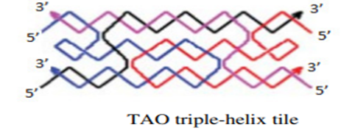
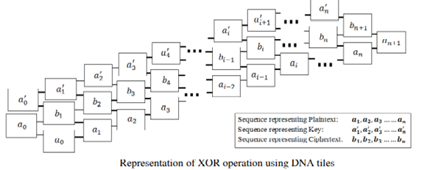
Step 6: The reporter strand contains three domains. The first domain
(a1a2…an) encodes the input plaintext, the second domain
(a1’a2’…an’) encodes one-time pad (key) and the third domain
(b1b2..bn) represents the ciphertext. If a restriction site is
encoded between the second and third domain, the ciphertext
can be recovered from the reporter sequence
Step 7: According to the principle of the Vernam cipher, the same key n
sequence (a1’a2’…an’) is used for decryption. The plaintext can
be recovered by using scaffold strands representing ciphertext
(b1b2..bn) and key sequence as input assembly. The intended
output is, ai= bi ⊕ ai’
Step 8: After self-assembly of DNA tiling, the reporter strand , + is
recovered. R’=a1a2 … an. a1’a2’ … an’.b1b2..bn
Step 1: The n bits of the plaintext are encoded in the form of DNA
sequences and using appropriate linking sequences the
scaffold strand a1,a2 … … an is generated.
Step 2: The further portion of the scaffold strand a1’ + a2’+ … an’ +
can be formed using arbitrary inputs which is actually the
one-time pad of the scheme.
Step 3: The input assembly ,the tile structure is formed by
using the two types of input scaffold strands.
Step 4: An opening for hybridization of a single output tile is created
by the input assembly because of the un-complemented sticky
ends. After the introduction of the output tiles (i.e. encoded
ciphertext) because of the self-assembly of DNA tiles, it can
attach to the desired sticky ends.
Step 5: Reporter strand R=a1a2 … an. a1’a2’ … an’.b1b2..bn
where bi= ai ⊕ ai’
Date: 1-07-2020

Slide 8
TRIPLE STAGE DNA CRYPTOGRAPHY
Soni et al proposed a new algorithm of DNA cryptography based on the concept of Moore machine in automata theory. The authors claim that the designed cryptosystem is more dependable and the security of this technique relies on the three encryption stages which use Secret key, Auto generated Moore machine and Password. Automata theory can be defined as the study of abstract self-propelled devices which follow predetermined sequence of operations to solve computational problem automatically. Final state machine (FSM) is a type of automaton that can be defined as a machine with finite number of states and the automaton can be in exactly one state at any given time. Moore machine is a FSM which produces output depending only on the present state. It can be defined by a 6 tuple
M = ( Q , ∑ , ∆ , δ, λ , q₀ )
Q is a nonempty finite set of states.
∑ is a nonempty finite set of input symbols.
∆ is a finite set of output symbols.
δ is the input transition function, where δ: Q × ∑ → Q
λ is the output transition function, where λ: Q → ∆
q0 is the initial state, where q0 ∈ Q.
Date: 1-07-2020
8

Slide 9
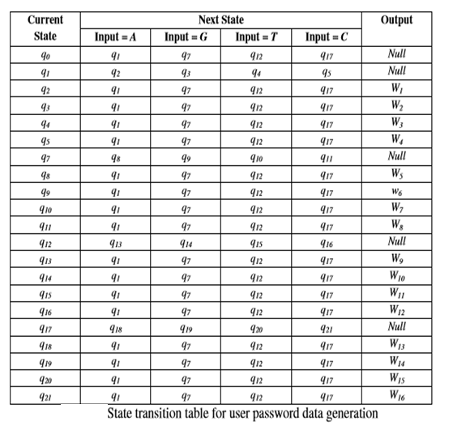
TRIPLE STAGE DNA CRYPTOGRAPHY
Step 1: The input hidden message is first encrypted by using user generated/ dynamically
generated secret key.
Step 2: The encrypted data is converted into binary sequence. The binary data is
partitioned in n number of blocks of size 256 bits each.
Step 3: The XOR operation is performed on the blocks.
Step 4: The output of the XOR operation is converted into DNA sequence following the
codebook-I .
Step 5: In this step Moore machine takes the resultant DNA sequence of step 4 as input and
produces user password data as output. The transition table (Table 5) for generating
user password data is given below.
Date: 1-07-2020

Slide 10
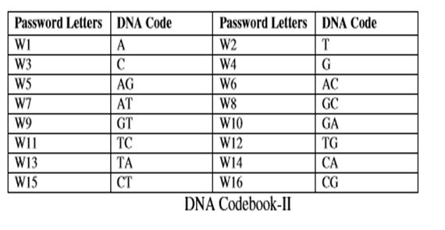
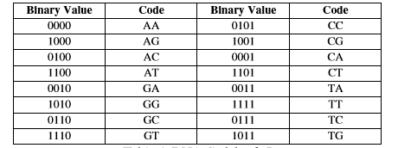
TRIPLE STAGE DNA CRYPTOGRAPHY
Step 6: The newly created user password data is again converted in DNA sequence following DNA codebook-II (Table 6). The
resultant sequence is the final encrypted data which is sent to the intended recipient.
Because of the multiple layers in the encryption methodology, the authors assert that the proposed algorithm is very
difficult to break. The added advantage of the algorithm is handling a broad range of plaintext in terms of data size.
Date: 1-07-2020
10

Slide 11
DNA STEGANOGRAPHY
Step 1: The plaintext is represented in the form of input DNA strands.
Step 2: The input strands are tagged with secret key which are also in the form of DNA sequence.
Step 3: These strands are mixed with random DNA strands which are specified as distracter.
Step 4: If the secret key is known to the receiver then the strands representing the plaintext can be extracted from the mixed up solution following affinity purification protocol. The single stranded sequence used in the experiment is the complementary sequence of the secret key.
The disadvantage of this method is that the sequence representing the original text can be recovered based on the entropy difference between the distracter and the input DNA strands i.e. plaintext. This difference can be reduced by designing the distracter sequence similar to the input DNA sequence. Otherwise, to match the distribution between the distracter and the sequence representing the plaintext DNA-SIEVE [Gehani et al., 1999] can be used. It shapes the set of random distracters into one for distribution match. Another technique of entropy reduction is, if making the plaintext to imitate the distracter. This can be achieved by compressing the plaintext with lossless algorithm [Ziv & Lempel, 1977].
Date: 1-07-2020
11

Slide 12
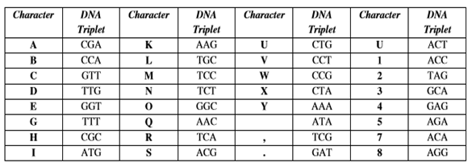
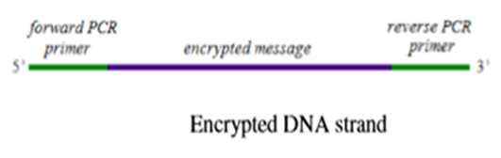
DNA STEGANOGRAPHY
Step 3: The encrypted strands are hidden within fragmented and denatured human genomic DNA. This is the first layer of steganography. Random combination of genomic DNA from different organisms can also be used to increase the complexity of the background. The intended recipient will not be affected by the vast mixtures of genomic DNA as the pair of primer sequences are known to them.
Step 4: The second layer of steganography is the confinement of the sample into DNA microdot. By this step even the medium containing the encrypted message can be obscured from the adversary. The intended recipients, who know both the encryption key and primer sequences, can only amplify the encrypted DNA sequence, extract the sequence, read it and finally decrypt the secret message.
By this proposed method individual secret messages can be sent to each of several intended recipients by using single or duplicate microdots. Each recipient use a unique primer pairs for amplification of the particular message which is sent to him/her. The authors claimed that, by this technique encrypted DNA sequences concealed within the genome can be attached using common adhesives to full stops in a printed innocuous letter. It can be also posted through the U.S. Postal Service. The embedded text can be efficiently decoded. Thus, confidential message can be transmitted securely.
Step 1: The original text is encrypted in terms of DNA sequence using substitution cipher. Each character is replaced by DNA triplets using the following encryption key .
Step 2: The encrypted message in the DNA strand is edged by two 20 bases long forward and reverse PCR primer sequences (Fig. 9). The primers are used for amplification of the encrypted segment of the DNA strand.
Date: 1-07-2020
12

Slide 13
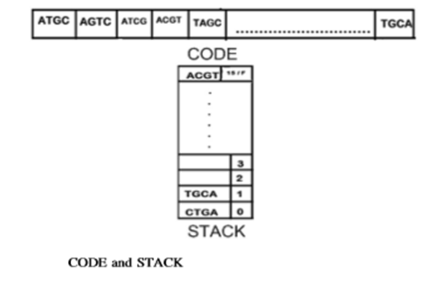
ENCRYPTION
Step 1: Finding all the 24 combinations of ATGC and storing them
in an array named CODE of size 24.
Step 2: STACK of size 16 is declared. Using random function,
generate numbers between 0 and 23. The number
generated, the corresponding ATGC combination of that
index in CODE would be placed at the top of the STACK.
Step 3: The pixel values of the image are fetched in matrix form.
Step 4: Finding the ﬁrst seven most occurring colours from the
matrix that are present in matrix.
Step 5: From the remaining eight combinations in CODE, seven
are again taken randomly and each of the most occurring
colour is specially assigned a combination. The
combinations being stored in an array MOST_OCCUR.
Date: 1-07-2020
13

Slide 14
ENCRYPTION
Step 6: The symbol ‘#’ is given a code which gets left after assigning all the 23 combinations corresponding to 0 to F and the most occurring
Step 7: The width and height of image are encoded with the codes corresponding to 0 to F in CODE and
written in a ﬁle named CODE_FILE with code of ‘#’ after width and height.
Step 8: The pixel values of the image (considering already in hexadecimal) in horizontal (X-axis) direction
is picked and stored in a variable ‘Hex’. Three cases can occur:
Case A: The color is one of the most occurring colors, then it is encoded with its corresponding code stored in MOST_OCCUR and written in the CODE_FILE.
Case B: The color is not among the most occurring seven colors. Then each character from ‘Hex’ will be extracted and encoded with the codes corresponding to its value (equal to index number, for ‘A’ to ‘F’ codes of 10–15 will be assigned) in CODE.
Case C: The color is same as that of previous color. Then a counter will count the number of times it is repeated. The ﬁnal number will encoded with the codes corresponding to 0–9 in CODE and written in CODE_FILE with the code of ‘#’ concatenated before and after it. For example, suppose ‘1010F1’ occurs 10 times serially. The above steps will get repeated till the end of the matrix containing the hexadecimal codes of the pixels of the image.
Step 9: The 7 most occurring colors will be treated as the normal colors and encoded similar to Case B of Step 8 and written in a separate ﬁle MOST_OCCUR_FILE
Date: 1-07-2020
14

Slide 15
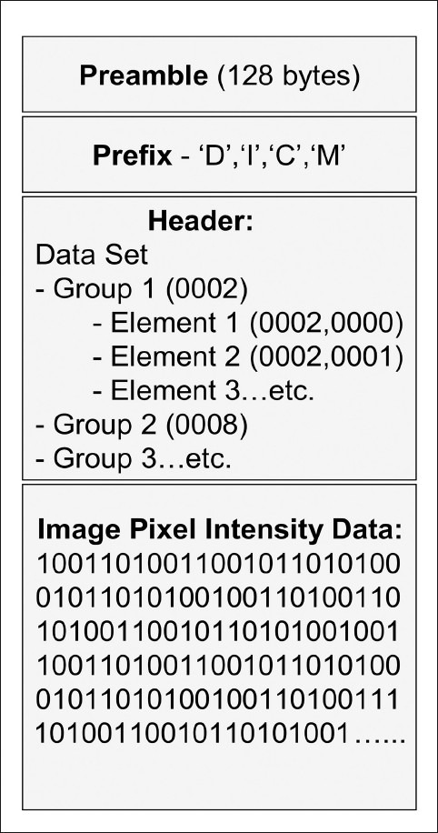
PARTS OF DICOM IMAGES
DICOM differs from other image formats in that it groups information into data sets. A DICOM file consists of a header and image data sets, all packed into a single file .
The first few packets of information in a DICOM image file constitute the “header.” It stores demographic information about the patient, acquisition parameters for the imaging study, image dimensions, matrix size, color space, and a host of additional non-intensity information required by the computer to correctly display the image. The header is followed by a single attribute (7FE0) that contains all the pixel intensity data for the image.
These data are stored as a long series of 0s and 1s, which can be reconstructed as the image by using the information from the header. This attribute may contain information regarding a single image, multiple frames of a study, or a cine loop, depending on the modality that has generated the image.
The header data information is encoded within the DICOM file so that it cannot be accidentally separated from the image data. If the header is separated from the image data, the computer will not know which imaging study has been done or to whom it belongs and it will not be able to display the image correctly, leading to a potential medicolegal situation.
Date: 1-07-2020

Slide 16
TECHNOLOGIES USED
We have used a user friendly software called Matlab which is a great platform to code and handle images.
We have created a GUI using Matlab.so when the code for image encryption is executes it displays the screen which asks us for the option to choose the image that we wish to encrypt and encrypted image is displayed and there is also option provided to decrypt.
Date: 1-07-2020

Slide 17
PROJECT OUTCOME
In this project an effort has been made to transfer vital images in encrypted the unsecured network. A simple algorithm in the form of random key generation has been used and certain ideas like assigning special codes to images has been incorporated. DNA cryptography is even less well studied, but ramped up work in cryptography over the past several years has laid good groundwork for applying DNA methodologies to cryptography and steganography. Researches and studies are being carried out to identify a better and unbreakable cryptographic standard. A number of schemes have been proposed that offer some level of DNA cryptography, and are being explored At present, work in DNA cryptography is centered on using DNA sequences to encode binary data in some form or another. Though the field is extremely complex and current work is still in the developmental stages, there is a lot of hope that DNA computing will act as a good technique for Information Security.
Date: 1-07-2020

Slide 18
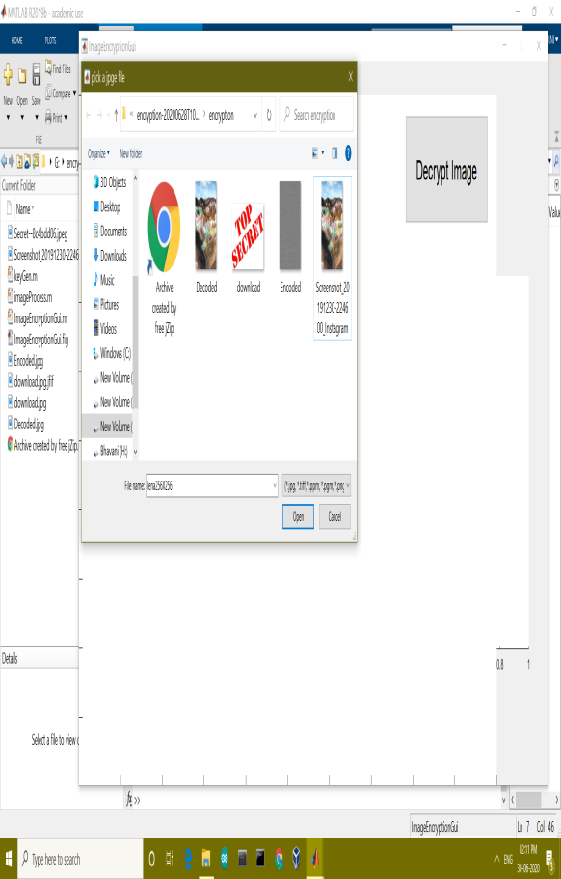
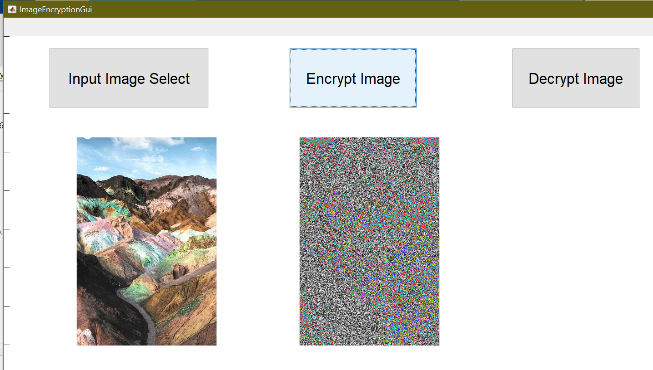
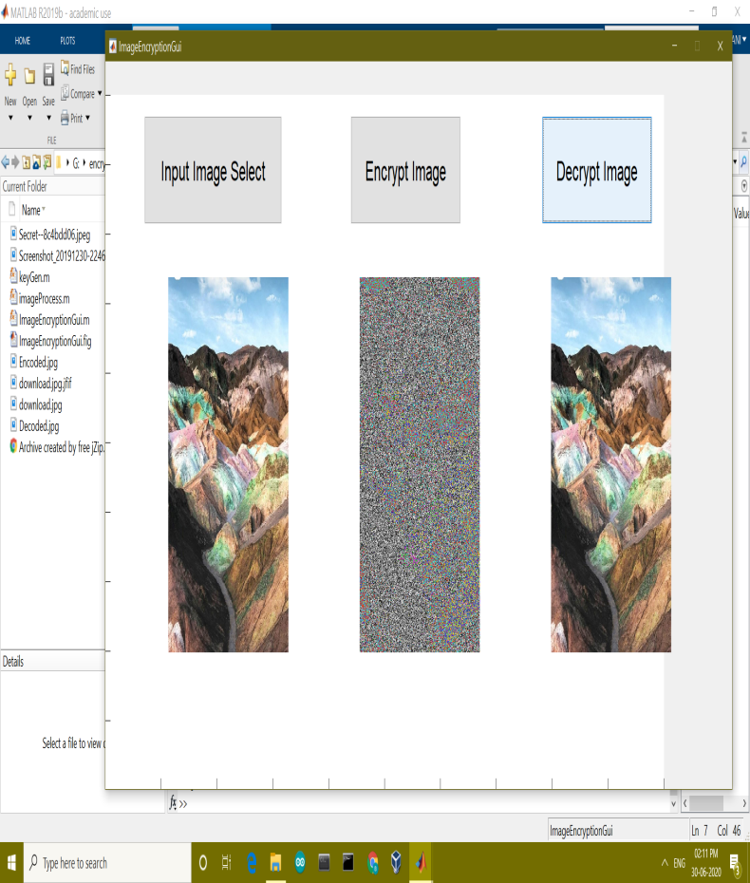
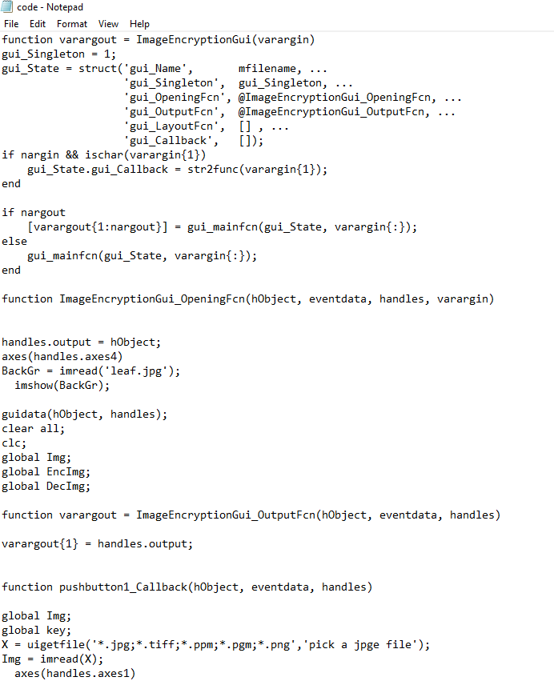
PROJECT DEMO
Date: 1-07-2020

Slide 19
Thank You
Date: 1-07-2020

